Slide 1
INFORMATION ASSURANCE AND SECURITY SEMINAR ON CROSS-SITE SCRIPTING -KESHVEE JAIN RA2011030010171

Slide 2
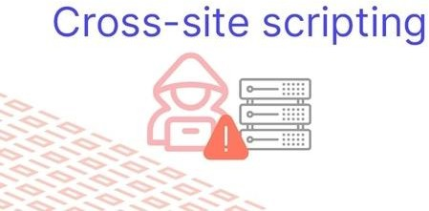
CROSS SITE SCRIPTING (XSS)
Cross site scripting (XSS) is a web security vulnerability that allows attacker to compromise victims in XSS attacker can send java script malicious code, to the victim after sending victim, he will be manipulate, can steal the cookies, account take over, session hijacking.
Types of cross site scripting attacks
Refelected XSS
Store XSS
Blind XSS
Dom XSS

Slide 3
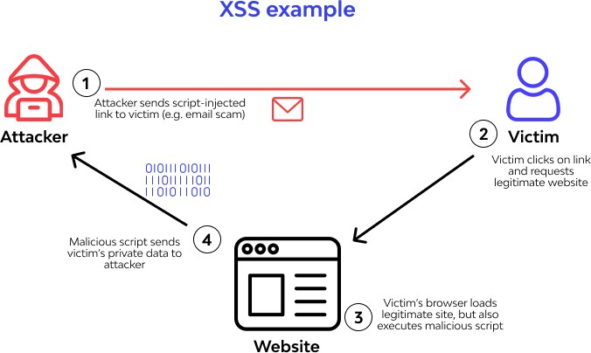
Reflected XSS
It is a client-side attack where the attacker injects a malicious script into the web application which reflects the payload here an attacker can take whole control of the script that is executed in the victim’s browser the cross-site scripting payload can be injected into the URL and search bar like this anywhere where inputs are available.
Impacts of reflected XSS
Hackers can steal user’s necessary credentials.
Hacker can also perform account takeover.
Hackers could also steal cookies and sessions hijacking.
Hackers can extract user’s sensitive data.

Slide 4
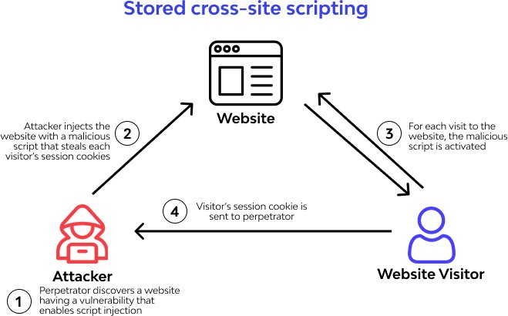
Stored XSS
This is something where the attacker sends a malicious link victim which reflects in the server here we can understand that in stored XSS, the payload is stored such in the field of the chat box, name, address, Difference between reflected XSS and stored XSS is simple here in reflected XSS here attacker is attacking the client side, in stored here attacker is attacking to server-side
Stored XSS VS Reflected XSS
Reflected XSS → STORE ═ reflect back
Stored XSS → DATABASE ═ Reflect Back
Impacts of Stored XSS
Hackers can deface the website
Hackers can steal the user’s credentials
Hackers also can perform hijacking users session’s
Hackers can takedowns user accounts and also take access to victim’s computer

Slide 5
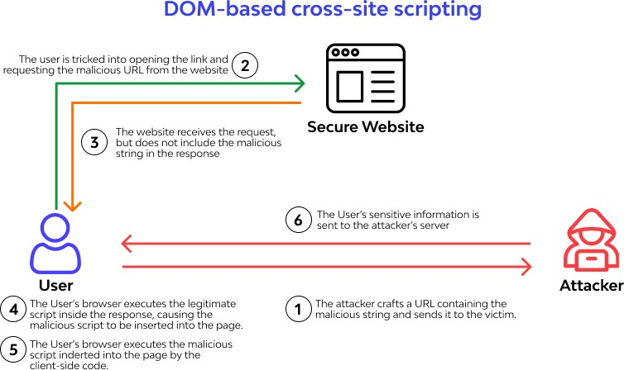
DOM (Document Object Model) based XSS
This sort of XSS attack is exceptionally best in class and it requires appropriate specialized skill to execute. DOM-based attacks are conceivable for the most part as a result of slight thoughtless code composing by the designers of the web application. On the off chance that the web engineers compose bits of information to the archive object model without appropriate tidying up, attackers can exploit it. They can exploit this imperfection to remember cross contents for the code (most occasions JavaScript codes) of the website application. A web application's construction is dictated by the HTML codes. HTML codes are put away in HTML archives. These records have a relating Document Object Model that decides the frontend of the web application – the properties of the report from the program's point of view. In the event that a cross-content is executed, it would approach the web's DOM. That way, it can control different highlights of the page's information and construction. A few items are utilized to execute DOM-based attacks. The most well-known among them are document.url, document.location, and document.referrer.

Slide 6
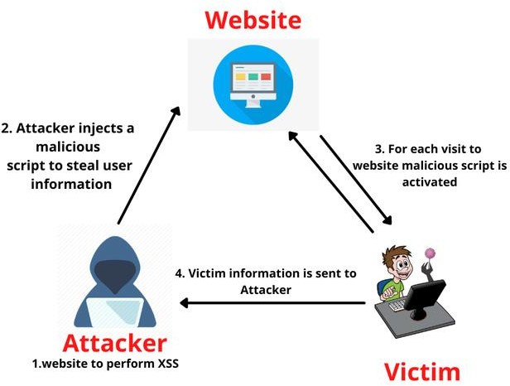
Blind XSS
Blind XSS is a vulnerability that is some sort of similar to stored but here the catch is the attacker makes a payload which is connected with his own server he made up payload with his server for example:
Attacker target a website.
Now he is injecting a malicious script to steal user information.
He needs to wait for victims to visit the website and for malicious script to be activated.
Now victims’ information is sent to the attacker for a while to days and he finally got access.
Impacts of Blind XSS
Hackers can perform hijacking user’s currents sessions.
Hackers can perform phishing attacks.
Hackers can perform a man in the middle attacks.

Slide 7
Prevention of Cross Site Scripting Attacks
Validating
Web codes ought to be set under stricter examination. The contributions of the clients ought to be investigated to check for when vindictive orders have been executed. This thus subjects the codes to investigation techniques for whitelisting and boycotting which may ultimately bolt out genuine clients from getting to the administrations of the web applications.
What's the significance here: Whitelisting is a methodology of permitting just some arrangement of good arrangements of information (as per best acts of information coding) when there are various elements of substantial elements. For example, rather than coding a vacant info field for client reactions, you could utilize a drop-down box all things being equal. This is a strategy for approval and it decreases the odds of get siting through friendly designing methods.
Sanitizing the HTML code
This strategy keeps the attackers from misusing the Document Object Model of a web application. This is finished by utilizing a HTML 5 disinfection library to keep attackers from infusing perilous contents into the HTML entries.
Encoding characters in the info field
Another technique for forestalling XSS attacks is to encode the characters filled in the information fields by clients.
Testing the info fields for malignant lines of code
This is perhaps the best strategy for forestalling XSS attacks. Network protection preventive techniques against XSS would not be finished without appropriately testing the info fields at discontinuous spans. The testing can be manual through web application filtering strategies. These can assist with uncovering nitty- gritty escape clauses in the web code and information structure. Then again, you could utilize a web application firewall to keep your website from pernicious attacks from cross scripters.

Slide 8
5. As an additional action, you could attempt a content security policy
In present day programs, there is space for some content security approaches. With this, you can handle the source from which JavaScript codes stacked and executed. With these strategies, you can choose which codes you need your program to execute after appropriate examination. You could even set priority for your program not to execute certain lines of codes that you have decided risky.
References:
https://www.geeksforgeeks.org/understanding-blind-xss-for-bug- bounty-hunting/
https://portswigger.net/web-security/cross-site-scripting
https://owasp.org/www-community/attacks/xss/
https://www.acunetix.com/websitesecurity/cross-site-scripting/
https://www.synopsys.com/glossary/what-is-cross-site-scripting.html
https://images.google.com/

